Slide 1

IPL Data Analysis
Bet with Confidence

Slide 2
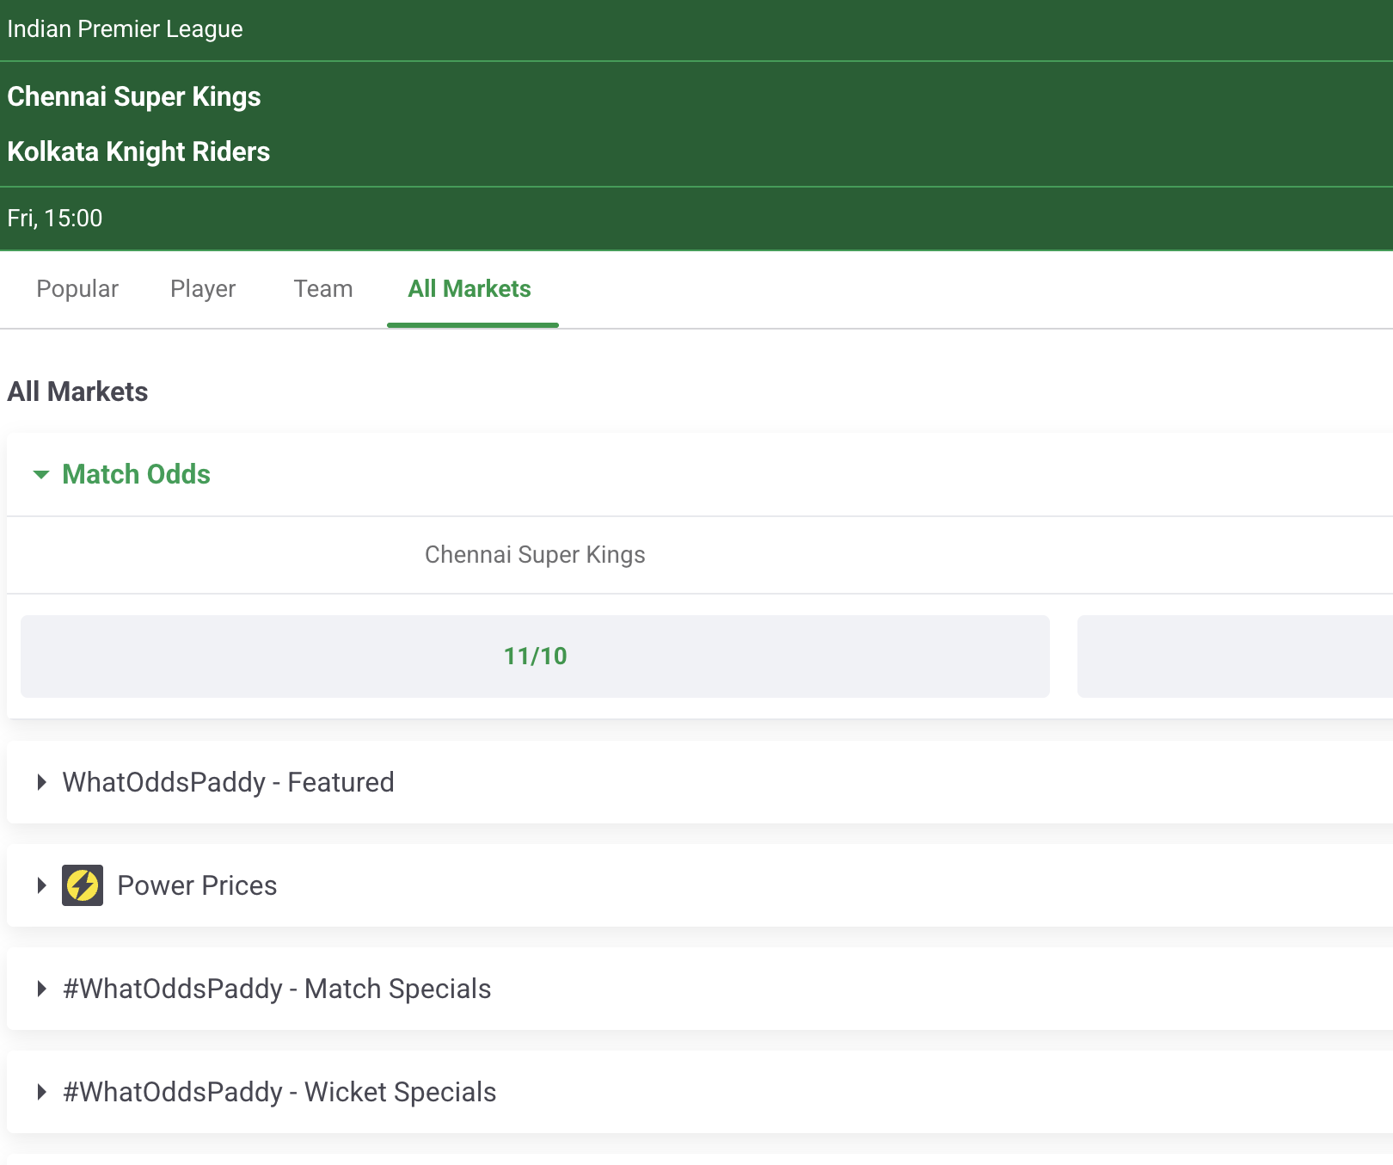
Paddy Power
Online platform where people bet in Ireland.
There are number of games other than cricket on the platform to bet on
We can leverage the power of data analysis in each of the game
Note that I don’t promote paddy power or Gambling

Slide 3
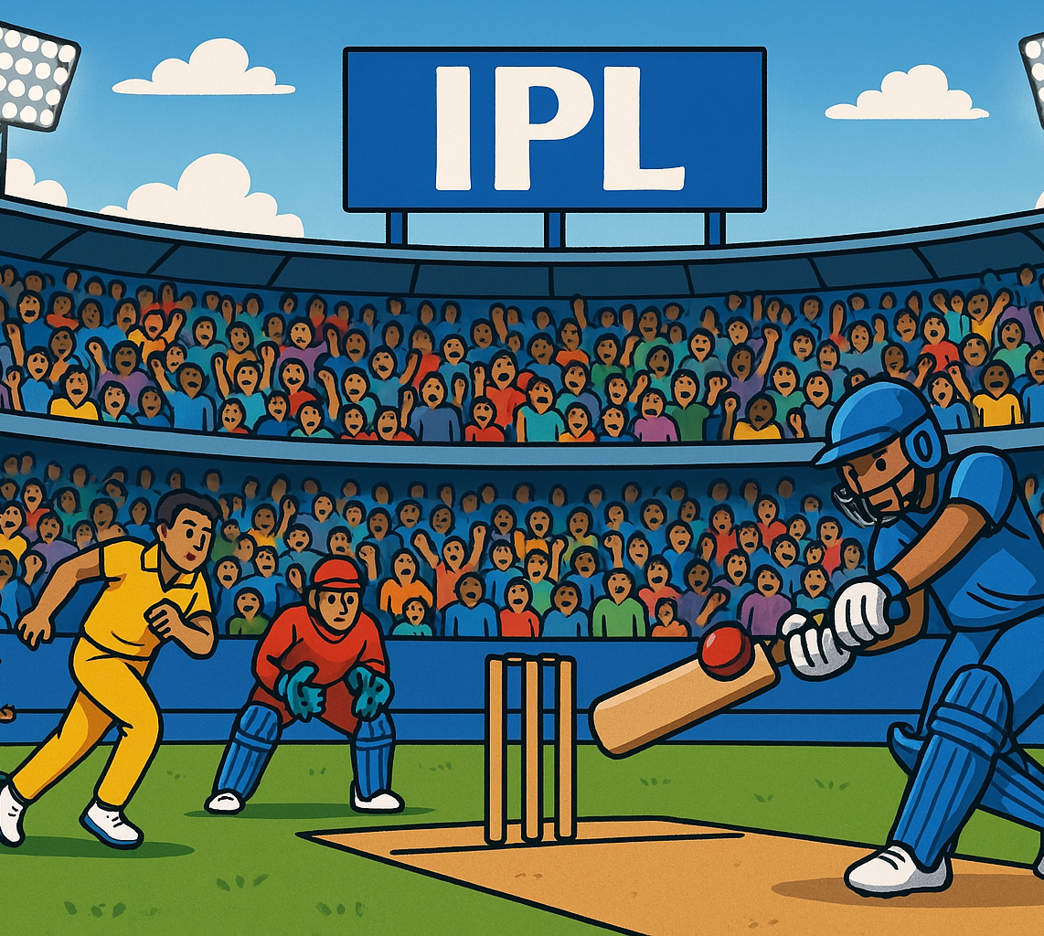
IPL – Indian Premier League
A Cricket Tournament held in India
Tell me your own Favorite team ?
What is IPL ?
A Brief about Dataset

Slide 4

Data Analysis
Team Vs Team
Batter Vs Team
Bowler Vs Team
Growth of Batsman
Growth of Bowler

Slide 5
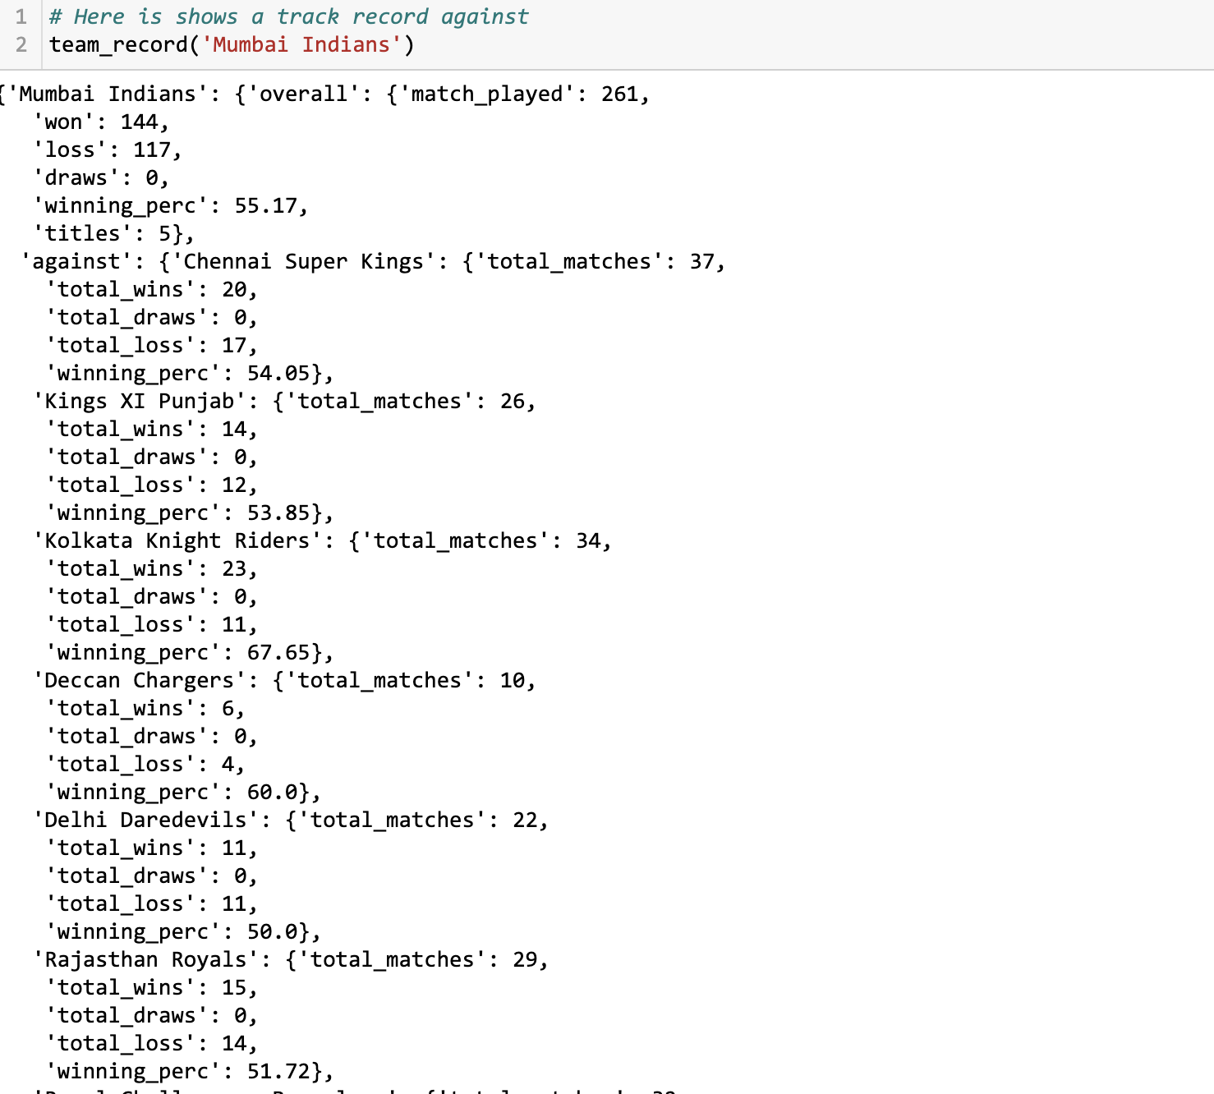
Team Vs Team
How Team Vs Team work ?
Which team is Stronger

Slide 6
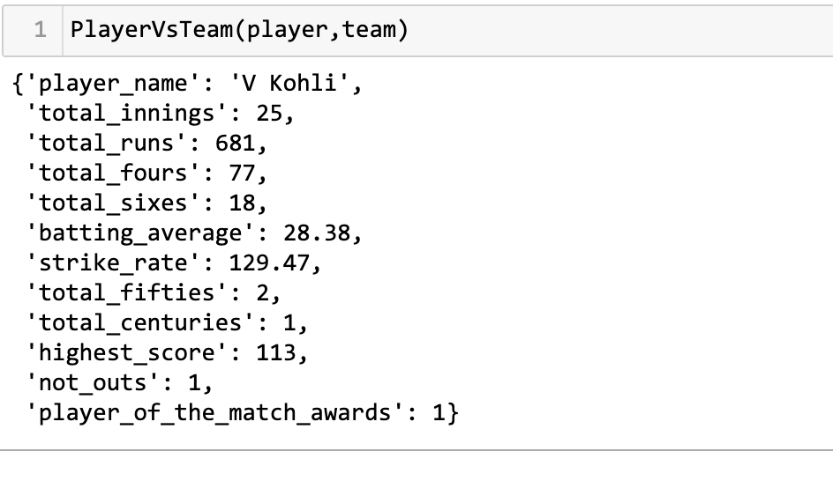
Batter Vs Team
How does it work ?
How did we include it in analysis ?

Slide 7
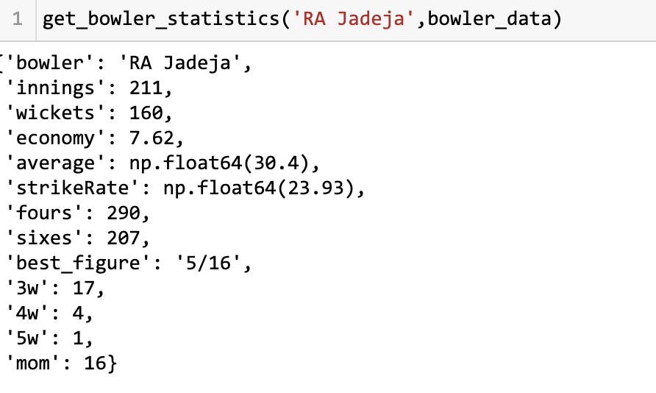
Bowler Vs Team
How does it work ?
How did we include it in analysis ?

Slide 8
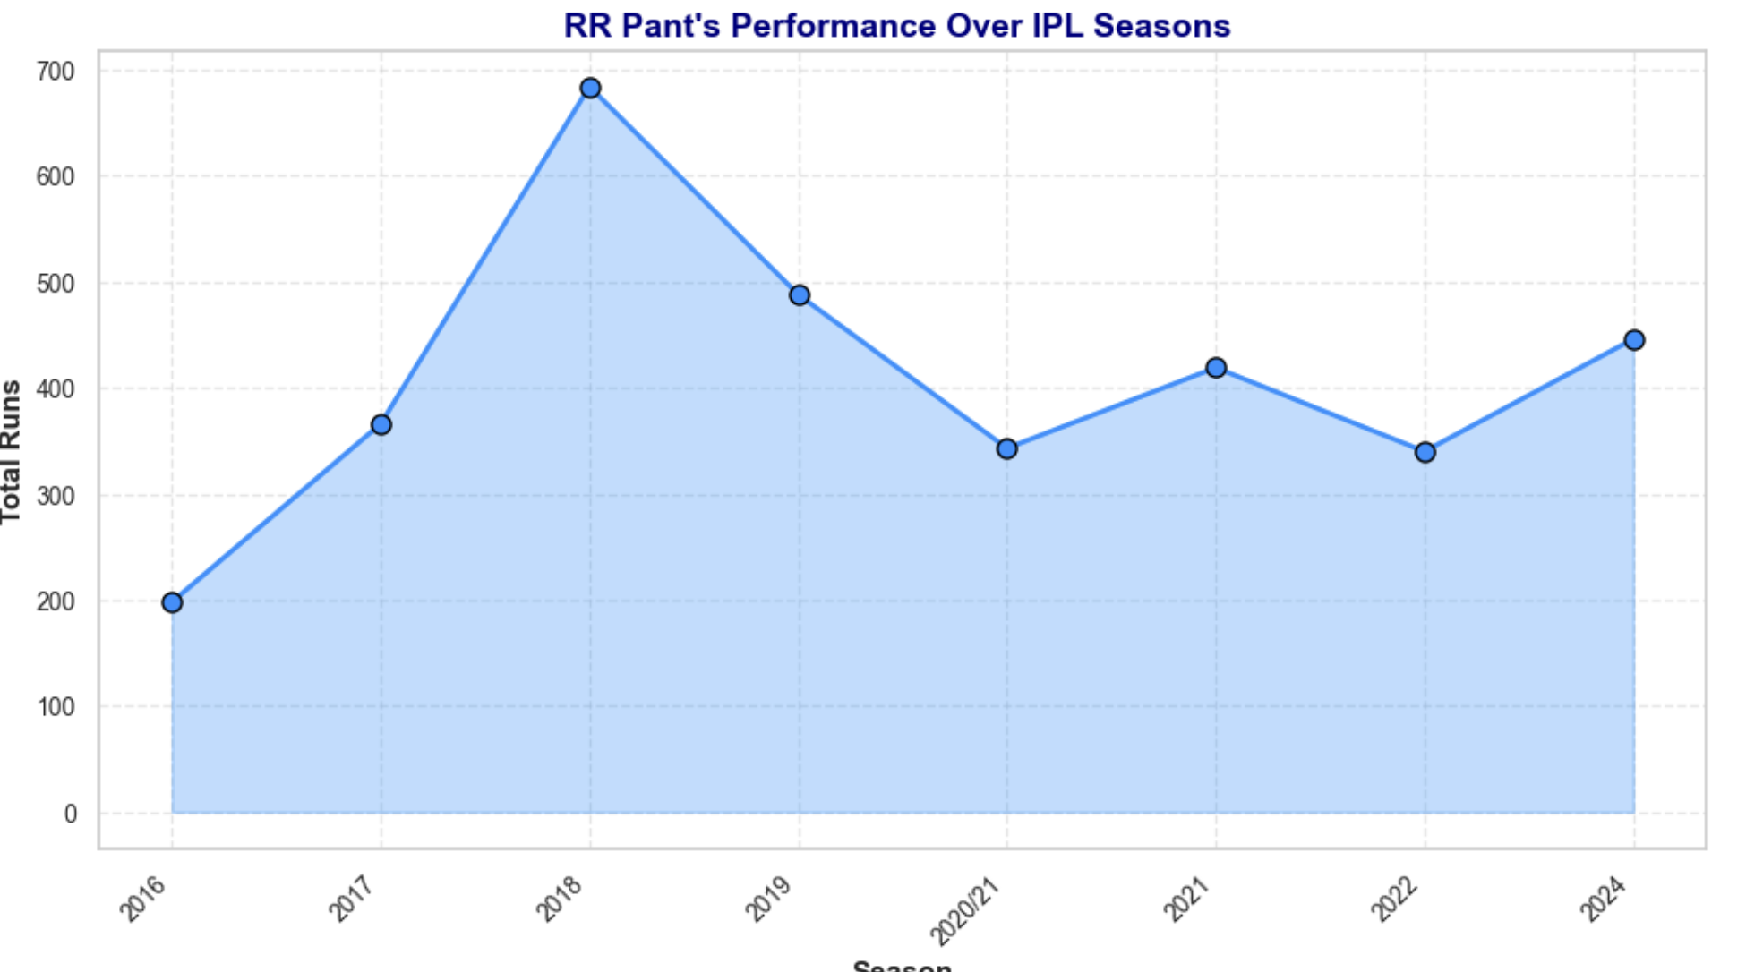
Growth of Batsman
How Growth of a Batsman affect the Game ?

Slide 9
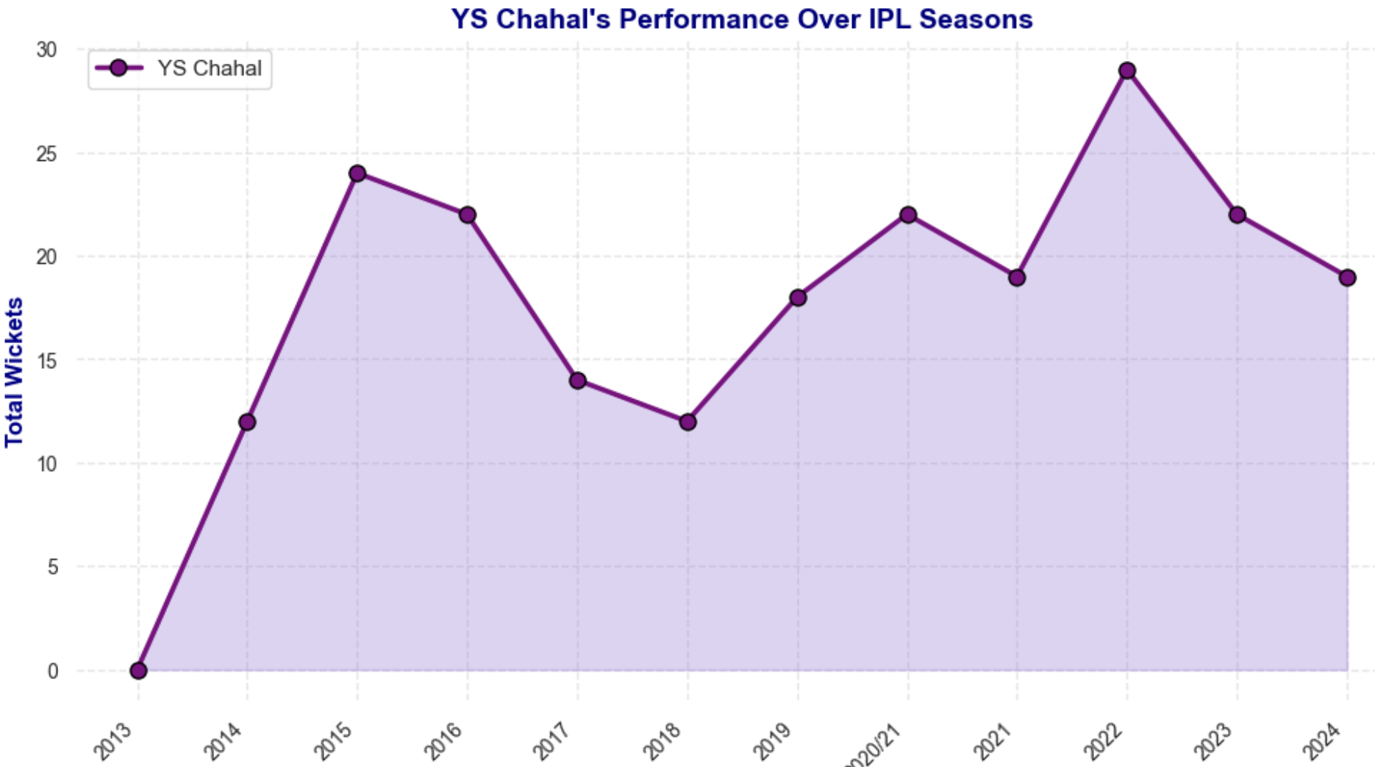
Growth of a Bowler
How Growth of a bowler affect the outcome of the match ?

Slide 10

Thank You
Let’s welcome the era of AI

